Slide 1


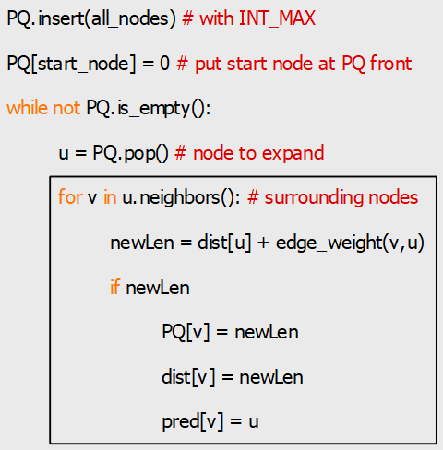
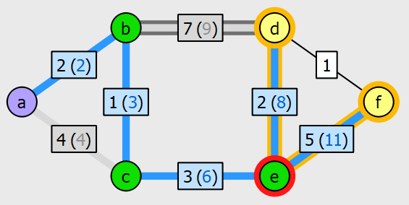
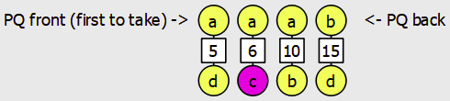


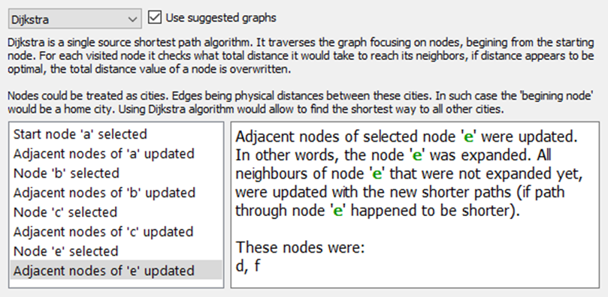
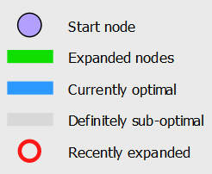
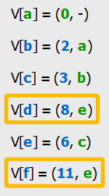
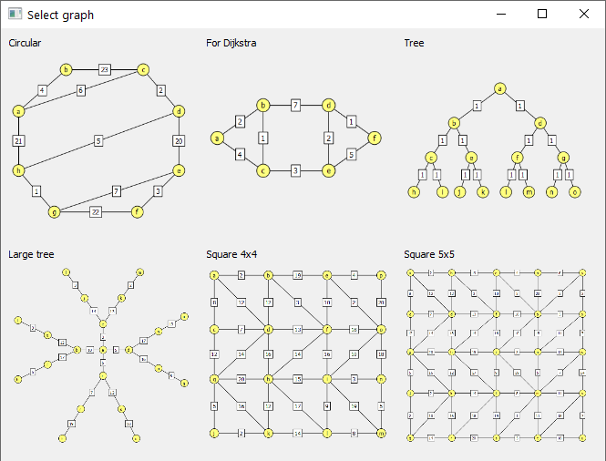

A tool for teaching graph algorithms
Created by Michal Borowski, supervised by Dr Alexandros Voudouris
DESCRIPTION
It’s a program that allows the user to create/edit graphs, select one of 5 available algorithms (Prim’s, Kruskal’s, Dijkstra’s, BFS, DFS), and observe a step-by-step execution of the selected algorithm and key data used by it. This is accomplished by coloring of the graph itself, as well as displaying algorithm state representation using several sub-windows including: step title/description window, Python-based pseudocode window, edge/vertex collection windows (e.g. priority queue, stack) and key data window (“V table”). When learning new concepts, working through practical examples “by hand on paper” is invaluable. While it can be easily done for algebraic equations, it isn’t as straightforward when learning about graph algorithms. Using this tool solves that problem, it makes graph creation quick and convenient, it improves learning experience by near-optimal representation of algorithm states and helps to consolidate understanding by using custom graphs.
EXAMPLE OF DIJKSTRA ALGORITHM
Image below shows the colored graph after few iterations of Dijkstra algorithm.
Different types of algorithms display different types of collection items. For example, Kruskal’s algorithm displays a priority queue of edges, instead of vertices. DFS displays a stack, and BFS displays a queue.
Computer science students are likely to be familiar with Python programming language, for that reason, the program displays Python-based pseudocode window, where the lines of code responsible for the last step of algorithm are highlighted.
Each step of algorithm (with a corresponding description) is logged in the algorithm selection window (shown below). Descriptions not only describe the principle in general, but also include labels of nodes/edges that were affected during a step.
At the top of algorithm selection window, we can see a short description of the algorithm itself with an example of use in real world circumstance.
The “Legend” item (shown below) describes what graph colors mean. The “V table” shows the key data used by Dijkstra algorithm, it highlights changes using orange color.
For the users' convenience a graph can be selected from multiple pre-defined graphs (shown below). It is possible to save previously created custom graph, it will be available from the graph selection window.
Priority queue item graphically shows which vertex will be expanded during the next iteration of Dijkstra algorithm, orange color highlights changes.

